Slide 1
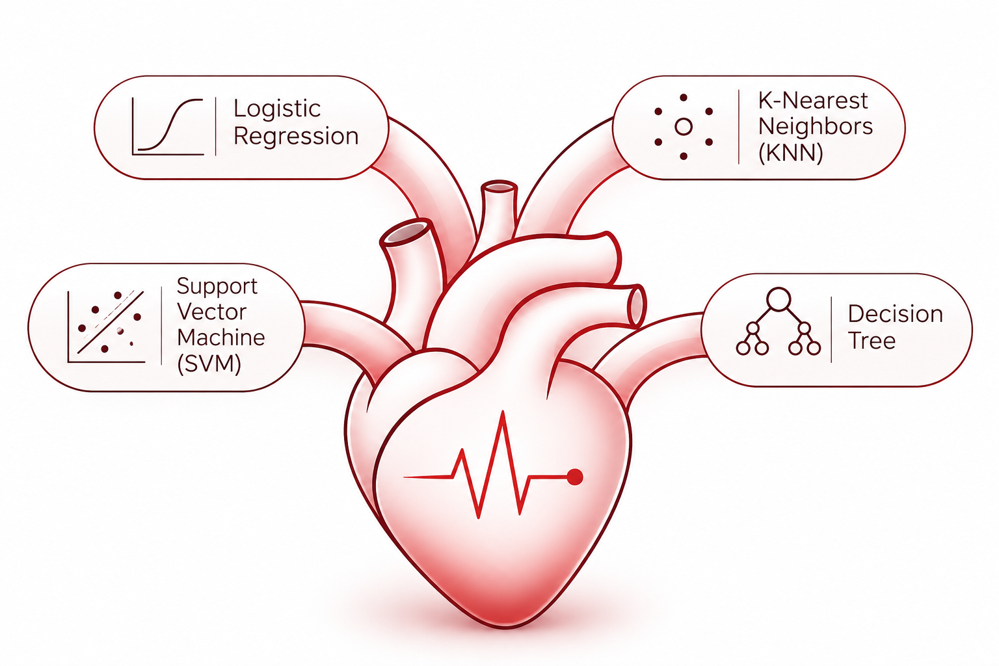
Heart Disease Prediction
Comparative Evaluation of Machine Learning Models:
Presented by:
Image generated with AI
Carlos Alvarez, Felipe Kuerten Neves & Karina Adorno
November 13th 2026
Notes:
Presenter: Karina. Hello everyone. Our project reproduces a research paper that uses machine learning to predict heart disease. I will present the problem, the paper and the data. Felipe will explain our methodology, our code and the reproduction of the paper, and Carlos will present the detailed results and our conclusions.

Slide 2
The problem
PART 1 · KARINA
Heart disease is the leading cause of death in the world.
Early detection can save lives.
Goal
Type of task
Why machine learning
Predict if a patient has heart disease or not, using clinical data.
Binary classification:
0 = No Disease,
1 = Heart Disease.
Help doctors identify patients at risk faster.
2
Notes:
Presenter: Karina. Heart disease is the number one cause of death in the world. The problem is simple: given clinical data from a patient, like age, chest pain type and heart rate, can a model predict if this patient has heart disease? This is a binary classification problem: the answer is 0, no disease, or 1, heart disease.

Slide 3
Data Lineage
PART 1 · KARINA
1988
1989
2026
UCI REPOSITORY
ORIGINAL CLINICAL PAPER
ML COMPARATIVE STUDY
Heart Disease collection donated to UCI.
76 raw attributes
Detrano et al.
303 Cleveland
425 Hungary
200 Long Beach
143 Switzerland
Total = 1,071 patients.
Aldila & Supriyono studied Cleveland only.
Logistic regression
SVM
KNN
Decision tree
Aldila, A. S., & Supriyono, L. A. (2026). Evaluating Logistic Regression, SVM, KNN, and Ensemble Models for Accurate Heart Disease Risk Prediction. JITK, 11(3), 949–957.
3
Notes:
Presenter: Karina. This is the paper we reproduced. It was published in 2026 and it is open access. The authors compared six classification models. KNN had the best accuracy, 88.5 percent, and Random Forest and SVM had the best AUC, 0.93. Random Forest and Gradient Boosting were not taught in class yet, so we reproduced the other four models.

Slide 4
The dataset: Cleveland Heart Disease (UCI)
PART 1 · KARINA
Feature | Meaning
age | Age in years
sex | 0 = female, 1 = male
cp | Chest pain type (4 types)
trestbps | Resting blood pressure
chol | Cholesterol
fbs | Fasting blood sugar > 120
restecg | Resting ECG result
Feature | Meaning
thalach | Maximum heart rate
exang | Chest pain during exercise
oldpeak | ST depression (ECG)
slope | Slope of the ST segment
ca | Number of major vessels (0–3)
thal | Thalassemia test result
num → target | Diagnosis (0–4 → 0 / 1)
303 patients · 13 features + 1 target
4
Notes:
Presenter: Karina. The dataset is the Cleveland Heart Disease dataset from the UCI repository, the same one used in the paper. It has 303 patients, 13 features and one target. Some features are numbers, like age and cholesterol, and some are categories, like chest pain type and thal. We used the processed file, because the raw file is reported as corrupted by UCI.

Slide 5
Data cleaning
PART 1 · KARINA
Missing values
Binary target
6 patients had missing values in ca or thal. As in the paper, they were removed.
The original diagnosis goes from 0 to 4. We grouped 1–4 as “disease”.
303 → 297
0 / 1
Class balance after cleaning
No Disease: 160 (54%)
Heart Disease: 137 (46%)
.
5
Notes:
Presenter: Karina. We followed the paper for data cleaning. Six patients had missing values in two columns, ca and thal, so we removed them. We now have 297 patients. The original target has five values, from 0 to 4. Zero means no disease, and 1 to 4 are different levels of disease, so we grouped them into one class. After cleaning, 54 percent of patients have no disease and 46 percent have heart disease, so the classes are balanced.

Slide 6
What the data shows
PART 1 · KARINA
Mostly men
Strongest relationships with heart disease
About 68% of the patients are male. The model may work less well for women.
Feature | Correlation
thal (thalassemia test) | +0.53
ca (major vessels) | +0.46
oldpeak (ST depression) | +0.42
exang (exercise angina) | +0.42
cp (chest pain type) | +0.41
thalach (max heart rate) | −0.42
Outliers kept
They are clinically possible, so we kept them, as the paper did.
Weak features
Cholesterol and blood sugar have almost no relation with the diagnosis.
6
Notes:
Presenter: Karina. Some highlights from our exploratory analysis. Most patients are men, which is a limitation. We found a few outliers, but they are possible in real patients, so we kept them, like the paper. The table shows the features most related to heart disease: thal, number of vessels, ST depression, exercise angina and chest pain type. A lower maximum heart rate is also related to disease. Now Felipe will explain our methodology.

Slide 7
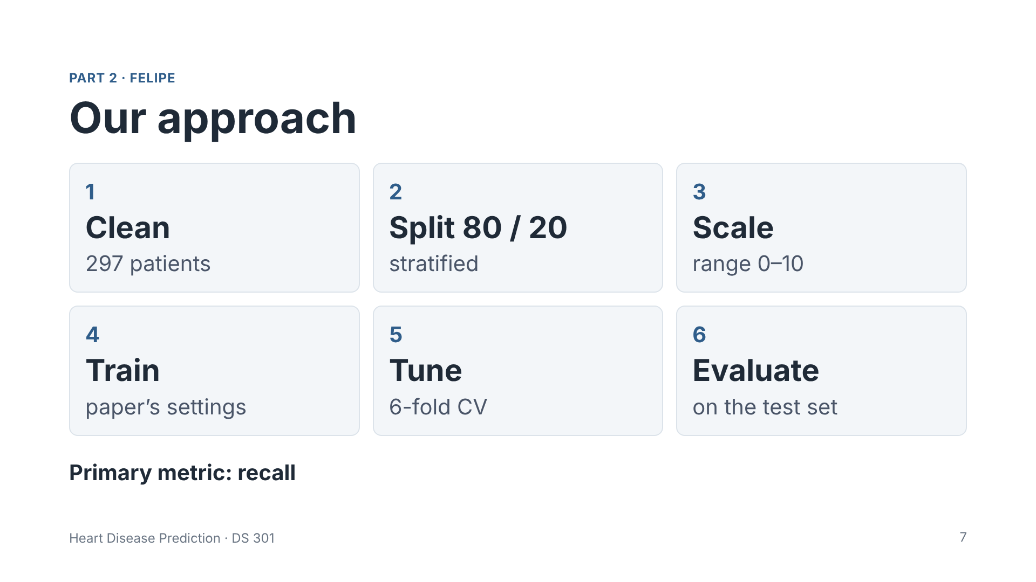
Notes:
Presenter: Felipe. This is our full process in six steps. After cleaning, we split the data: 80 percent for training and 20 percent for testing, keeping the same class balance. Then we encode and scale the features, train the four models with the paper's settings, tune them with cross-validation, and finally evaluate them on the test set. Our main metric is recall, because in medicine the worst error is to tell a sick patient that they are healthy.

Slide 8
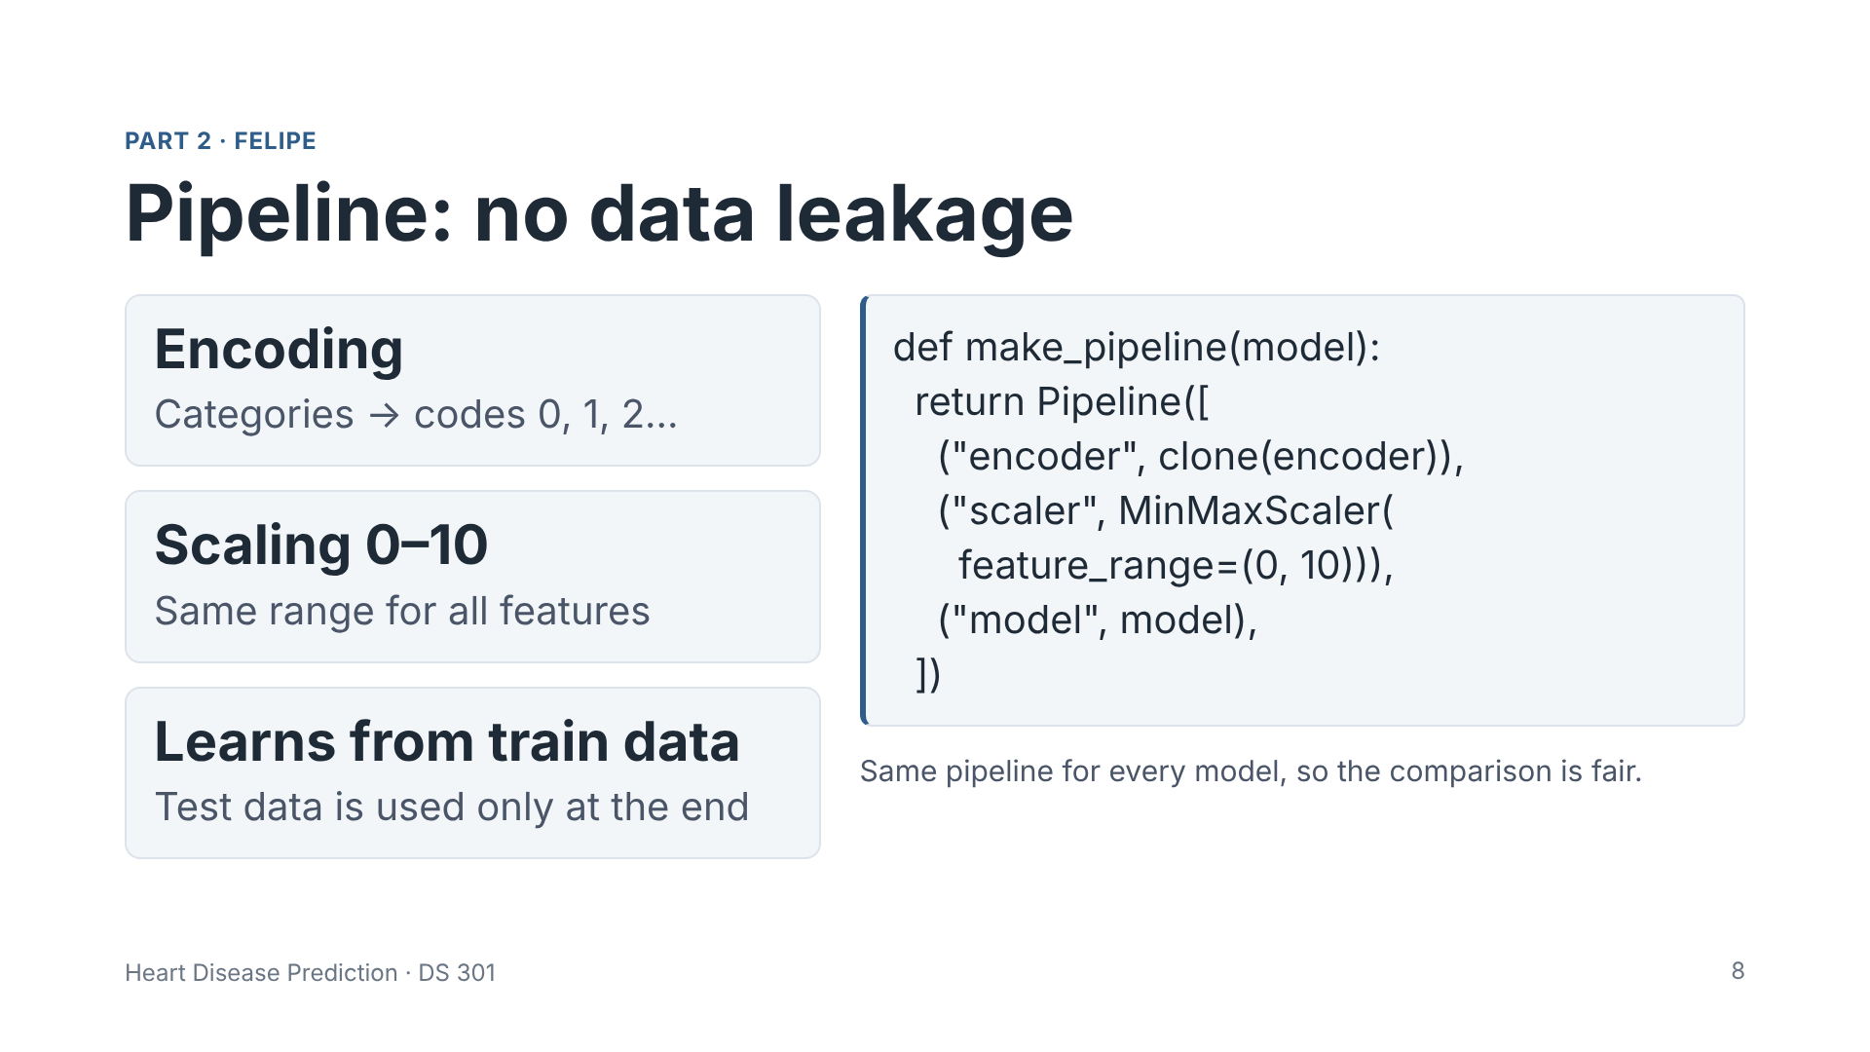
Notes:
Presenter: Felipe. Before training, the data goes through a pipeline with two steps. First, the categorical features, like chest pain type, are converted to number codes, as the paper did. Second, all features are scaled to the range 0 to 10, as the paper describes. This is important for KNN and SVM, because they use distances between patients. The pipeline learns the scaling only from the training data, and it is refitted in every cross-validation fold. This avoids data leakage: the test data never influences the model. We use the test data only at the end, to measure the results. And every model uses the same pipeline, so the comparison is fair.

Slide 9
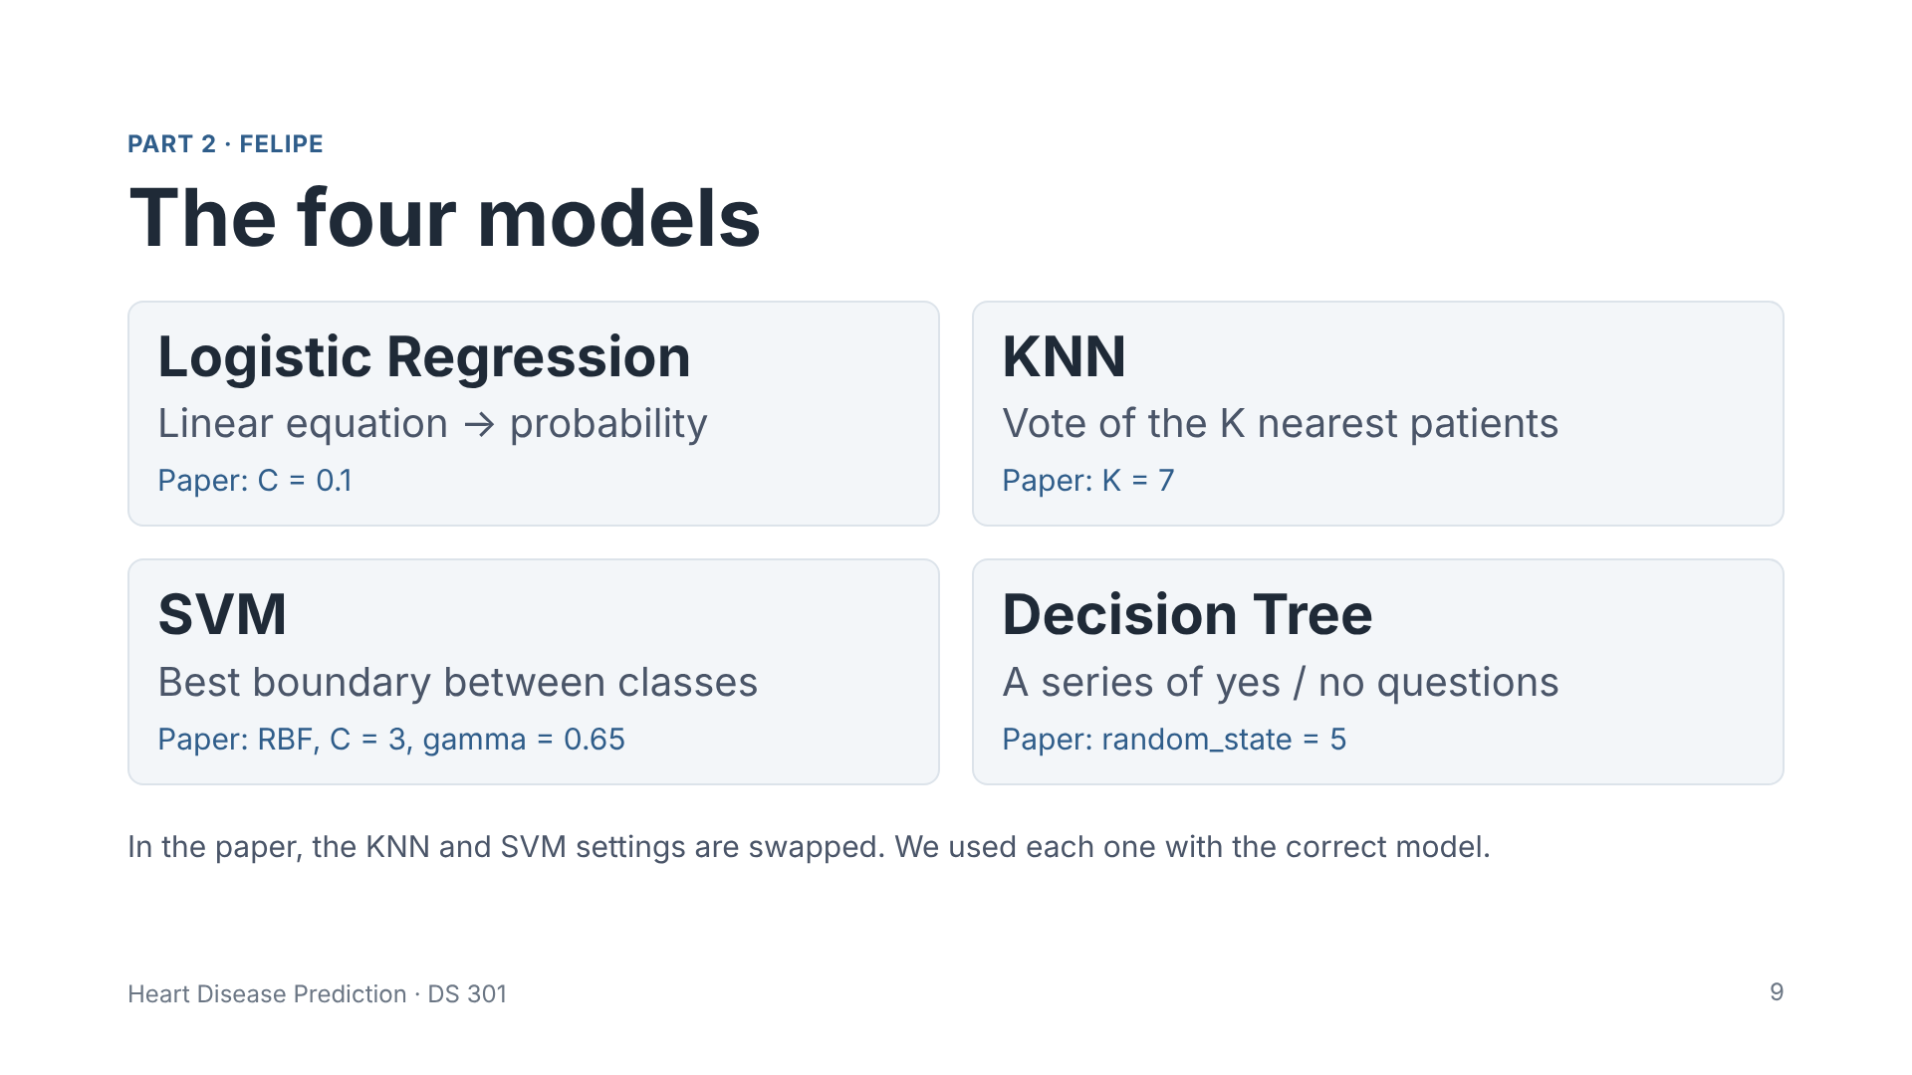
Notes:
Presenter: Felipe. These are the four models we reproduced. Logistic Regression estimates the probability that a patient has the disease. KNN, K-Nearest Neighbors, looks at the K most similar patients and takes the majority. SVM, Support Vector Machine, finds the boundary that best separates the two groups. And the Decision Tree asks a series of yes or no questions. Under each model, you can see the settings reported in the paper.

Slide 10
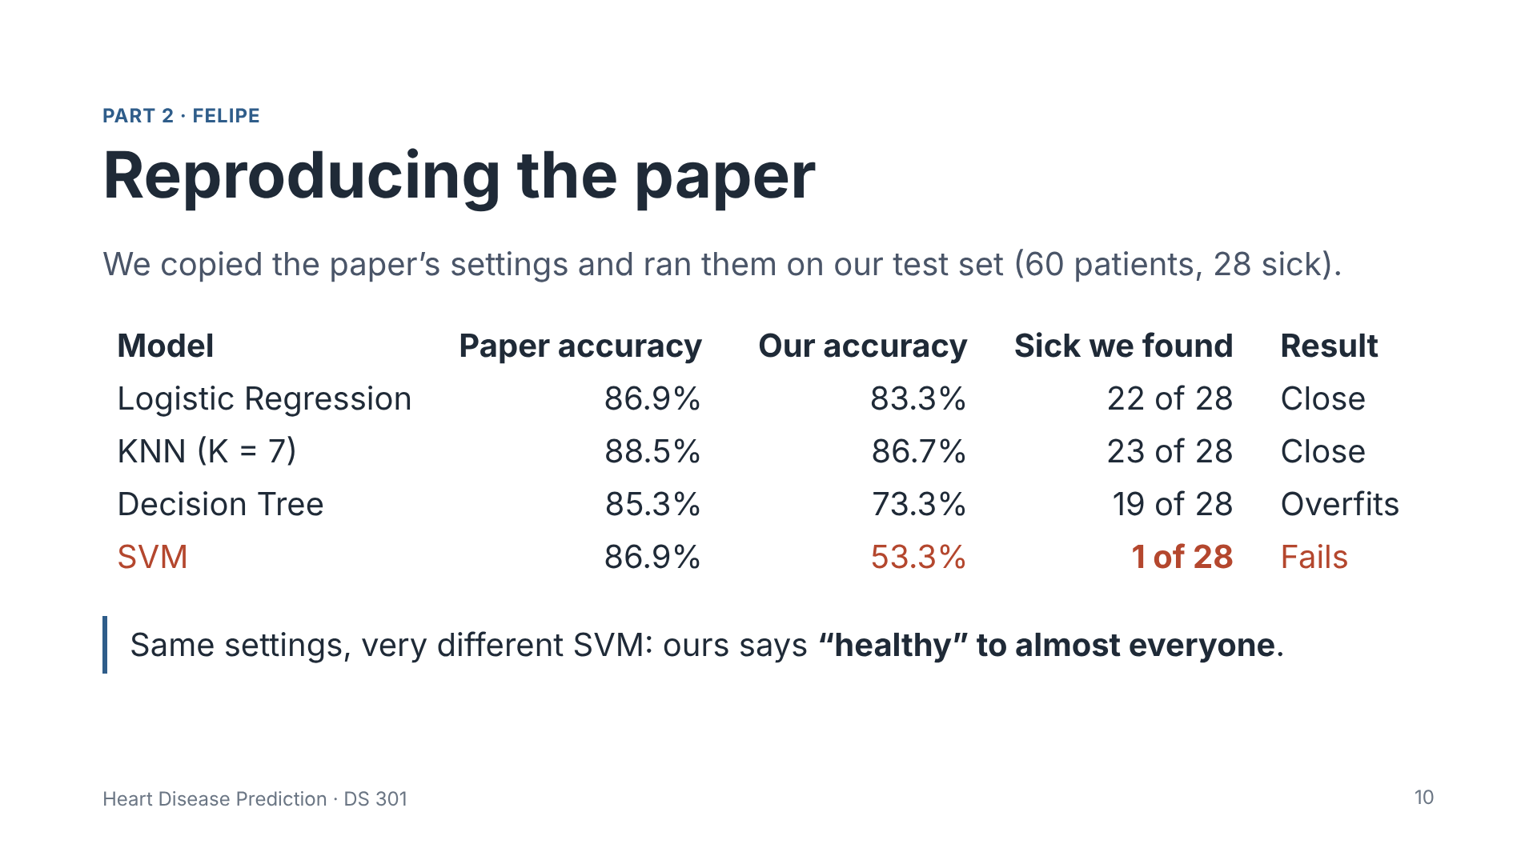
Notes:
Presenter: Felipe. First, we copied the settings written in the paper and ran them ourselves. The first column is the accuracy the paper reports. The second is the accuracy we got with the same settings. Logistic Regression and KNN were close to the paper, and they found 22 and 23 of the 28 sick patients. The Decision Tree memorized the training data: 100 percent on training, but only 73 percent on the test. And the big surprise: in the paper, the SVM had 86.9 percent. With the same settings, our SVM had 53 percent. That may look OK, but it said healthy to almost everyone, and found only 1 of the 28 sick patients. That is why accuracy alone is not enough, and why we focus on recall.

Slide 11
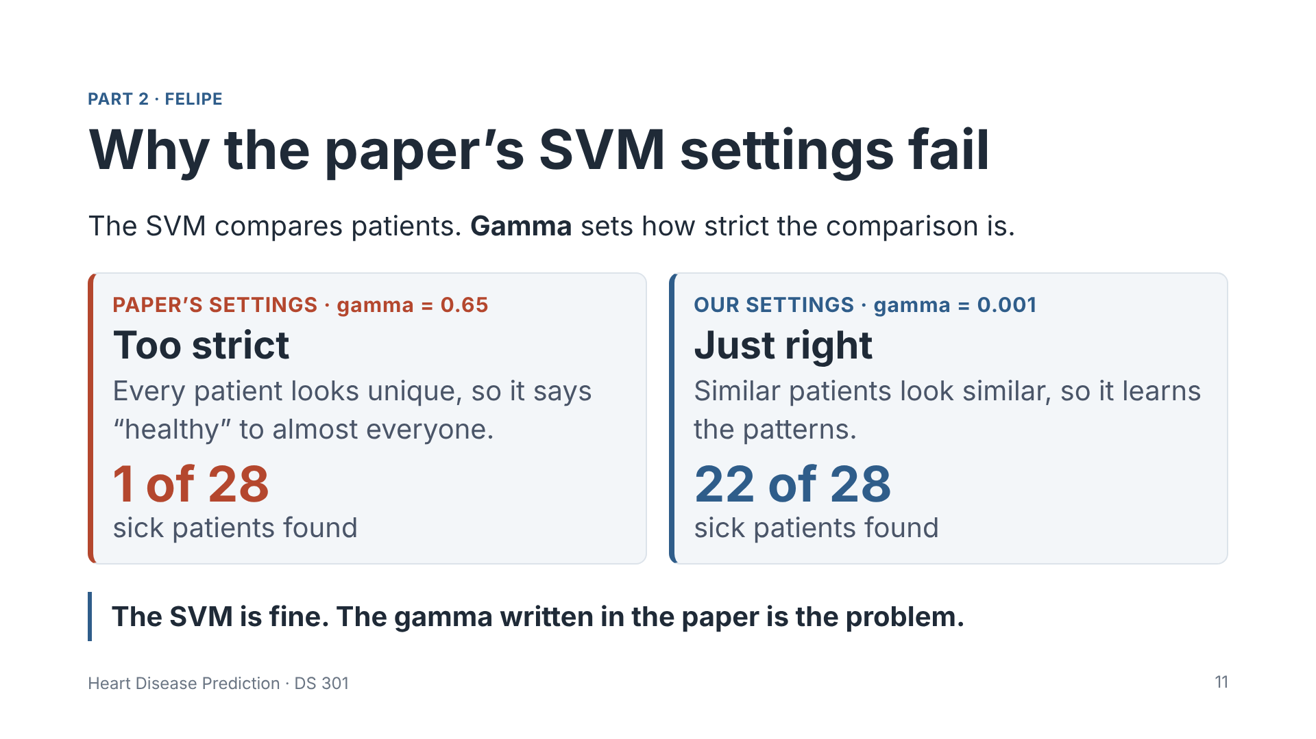
Notes:
Presenter: Felipe. Why did the SVM fail? The SVM works by comparing patients, to find the ones that are similar. Gamma controls how strict this comparison is. With the paper's gamma, 0.65, and the 0 to 10 scale, the comparison is too strict: every patient looks different from all the others, so the model cannot find patterns. It said healthy to almost everyone, and found only 1 of the 28 sick patients. With a smaller gamma, 0.001, similar patients are seen as similar, and the SVM works: it found 22 of the 28 sick patients. So the problem is not the SVM, only the gamma written in the paper.

Slide 12
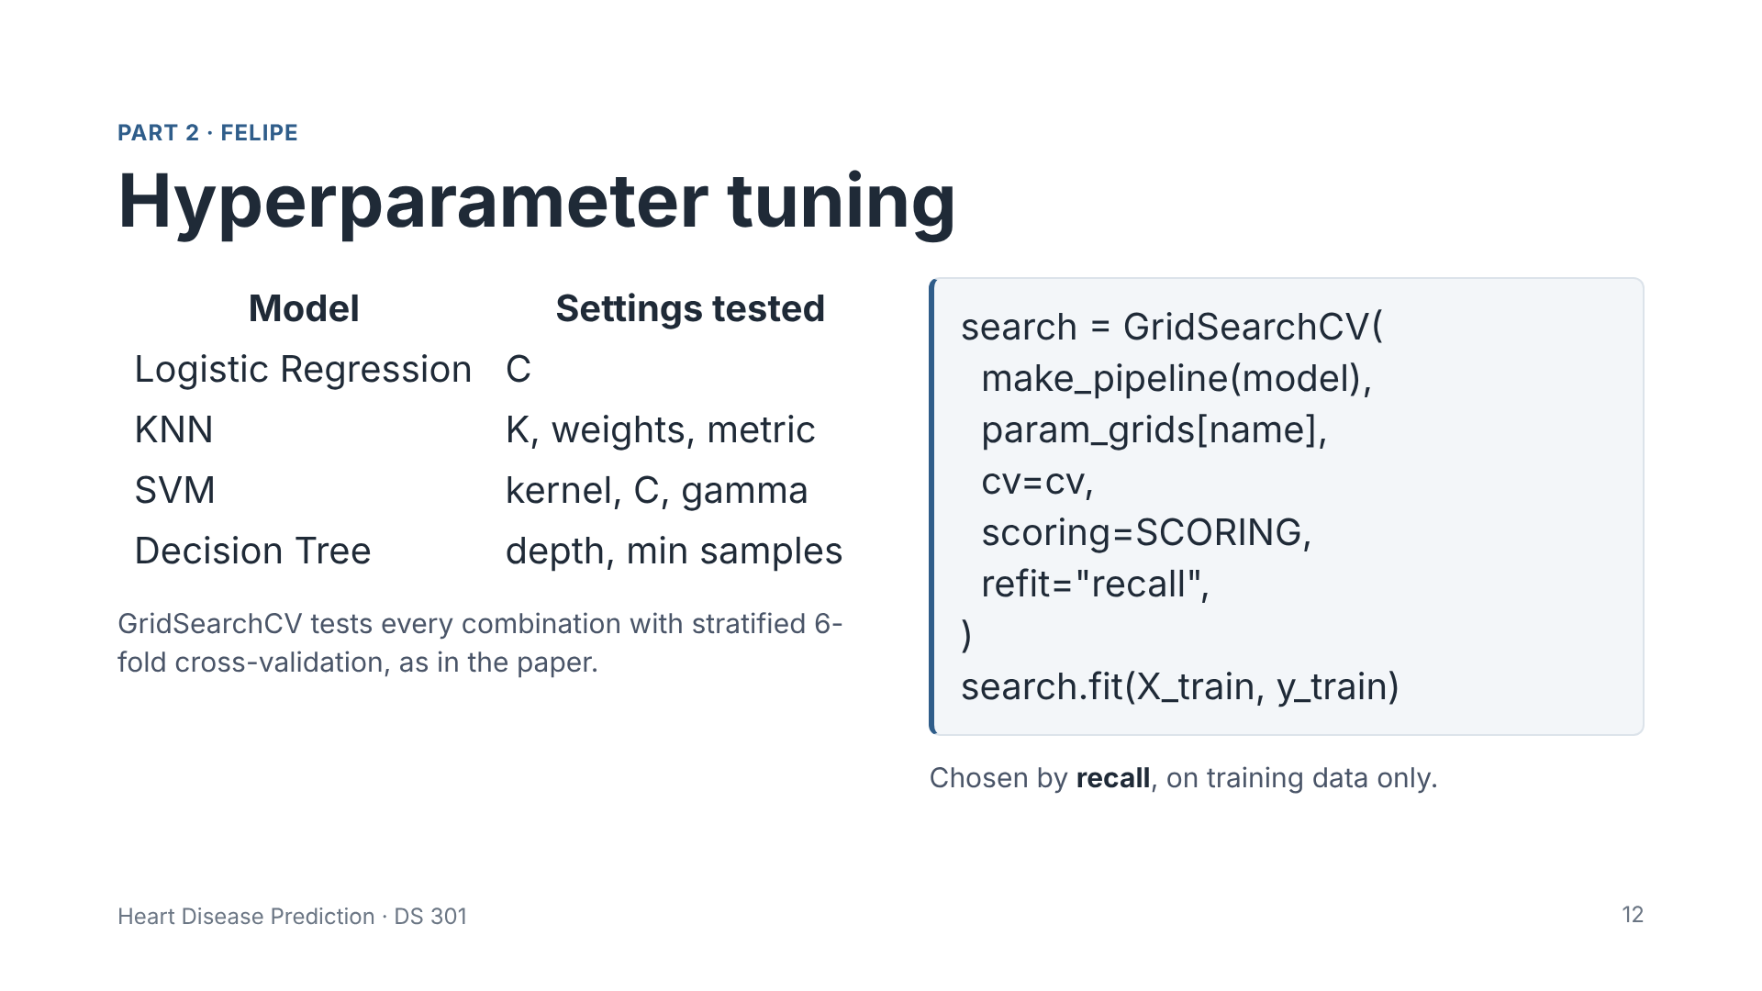
Notes:
Presenter: Felipe. So the paper's settings did not work well for us. Because of this, we looked for better settings for all four models. GridSearchCV tests every combination in this table, with six-fold cross-validation, like the paper. It picks the best one by recall. And it uses only the training data, so the test set stays hidden until the end.

Slide 13
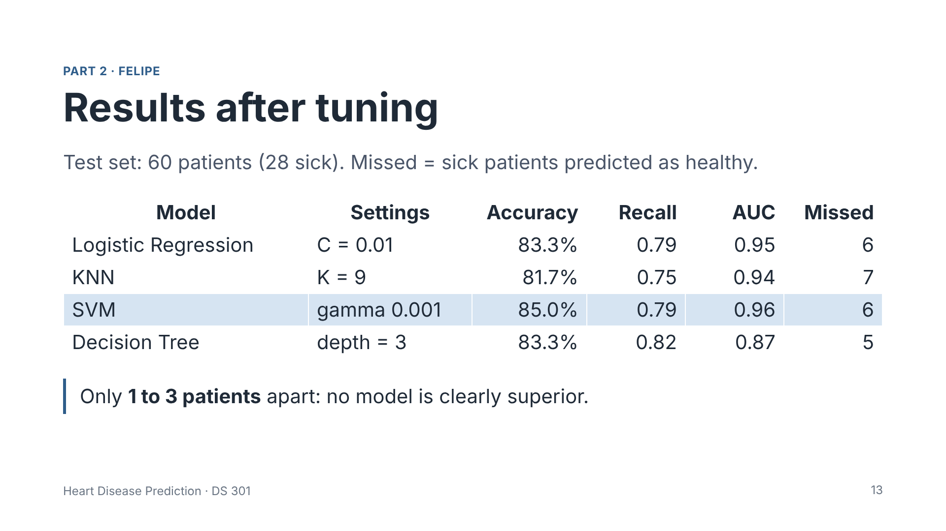
Notes:
Presenter: Felipe. These are the results after tuning. Remember the SVM that failed with the paper's settings? With the right gamma, it became the best model. The SVM, highlighted, had the best overall balance: the highest accuracy, 85 percent, and the highest AUC, 0.96. The Decision Tree had the highest recall: it missed only 5 of the 28 sick patients. But look at the last column: the differences between the models are only 1 to 3 patients. With such a small test set, we cannot say that one model is clearly better. Now Carlos will show these results in more detail.

Slide 14
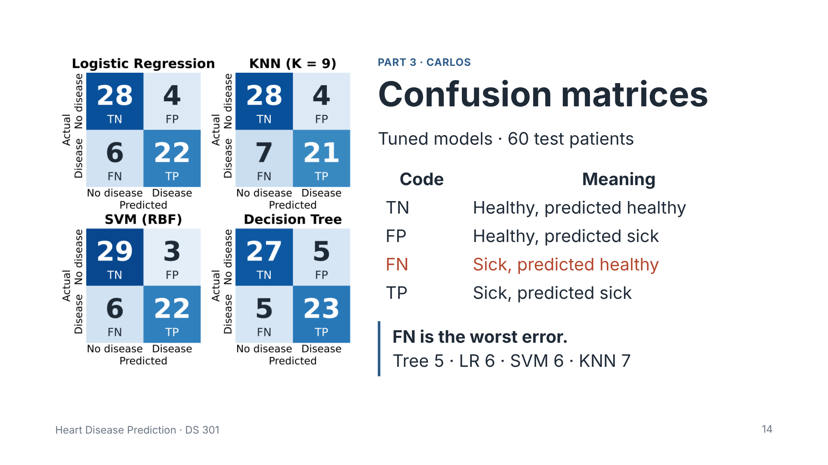
Notes:
Presenter: Carlos. Thank you, Felipe. Here are the confusion matrices of the four tuned models on the 60 test patients. Each matrix shows four numbers. The most important is FN, false negatives: sick patients that the model predicted as healthy. The Decision Tree had the fewest, 5, then Logistic Regression and SVM with 6, and KNN with 7. The SVM had the fewest false positives, only 3. The differences between the models are very small.

Slide 15
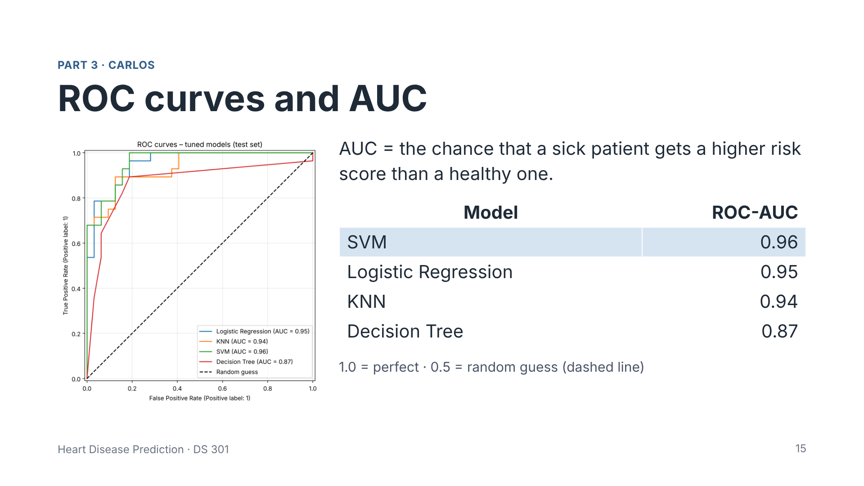
Notes:
Presenter: Carlos. The ROC curve shows how well each model separates sick and healthy patients at every threshold. AUC is the area under the curve: it is the chance that a sick patient gets a higher risk score than a healthy one. SVM, Logistic Regression and KNN are all above 0.94. The Decision Tree is lower, 0.87, because a small tree gives only a few different probability values.

Slide 16
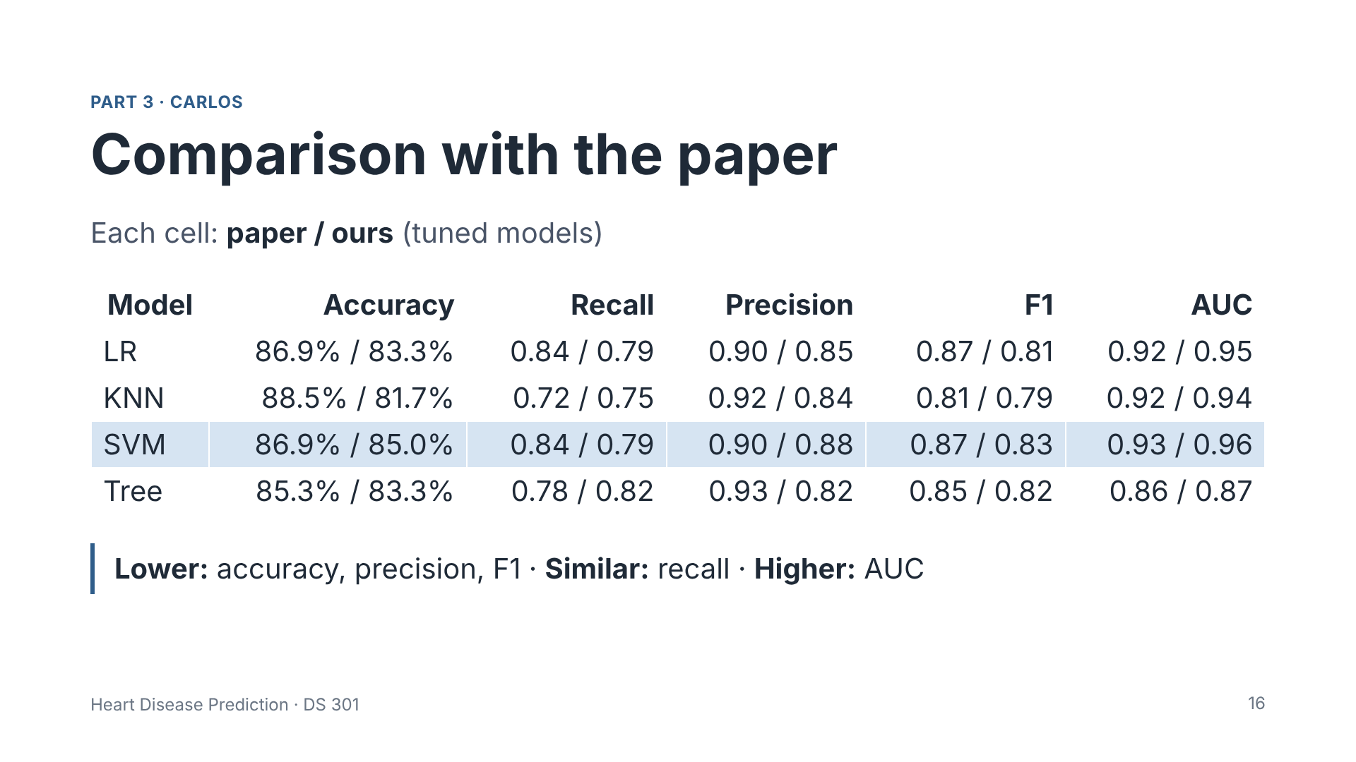
Notes:
Presenter: Carlos. This table compares every metric the paper reports with our tuned results. In each cell, the first number is the paper and the second is ours. Our accuracy, precision and F1 are a few points lower. Our recall is similar, and even higher for KNN and the Decision Tree. And our AUC is a little higher for all four models. The paper's accuracy is only 1 to 3 patients higher: its accuracy values match a test set of 61 patients, so it was probably different from ours, and it optimized accuracy, while we optimized recall. Because the paper does not report all its details, this is an approximate reproduction, but the level of performance is the same.

Slide 17
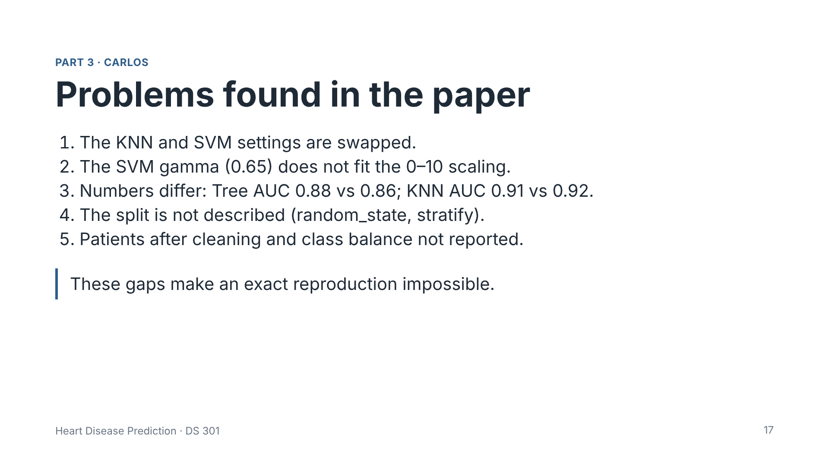
Notes:
Presenter: Carlos. While reproducing the paper, we found some problems. The KNN and SVM settings are swapped. The SVM gamma does not match the scaling. Some numbers are different between the text and the tables. And important details are missing, like how the data was split and how many patients remained after cleaning. Because of these gaps, an exact reproduction is not possible. Now Karina will present our suggested improvements.

Slide 18
Suggested improvements
PART 3 · Karina
Works with the default SVM settings.
One-hot encoding
Standard 0–1 scaling
Repeated CV
Categories like chest pain type have no natural order.
More stable results than one 60-patient test set.
Threshold tuning
More data
Report everything
Lower the threshold to miss fewer sick patients.
Add the other UCI hospitals.
Split, random_state and scaling order, so others can reproduce it.
18
Notes:
Presenter: Carlos. We did not implement these, but we suggest six improvements. One-hot encoding for categories without order. Standard scaling from 0 to 1. Repeated cross-validation for more stable results. Lowering the decision threshold to find more sick patients, accepting more false alarms. Adding data from the other hospitals in the UCI repository. And reporting the full methodology.

Slide 19
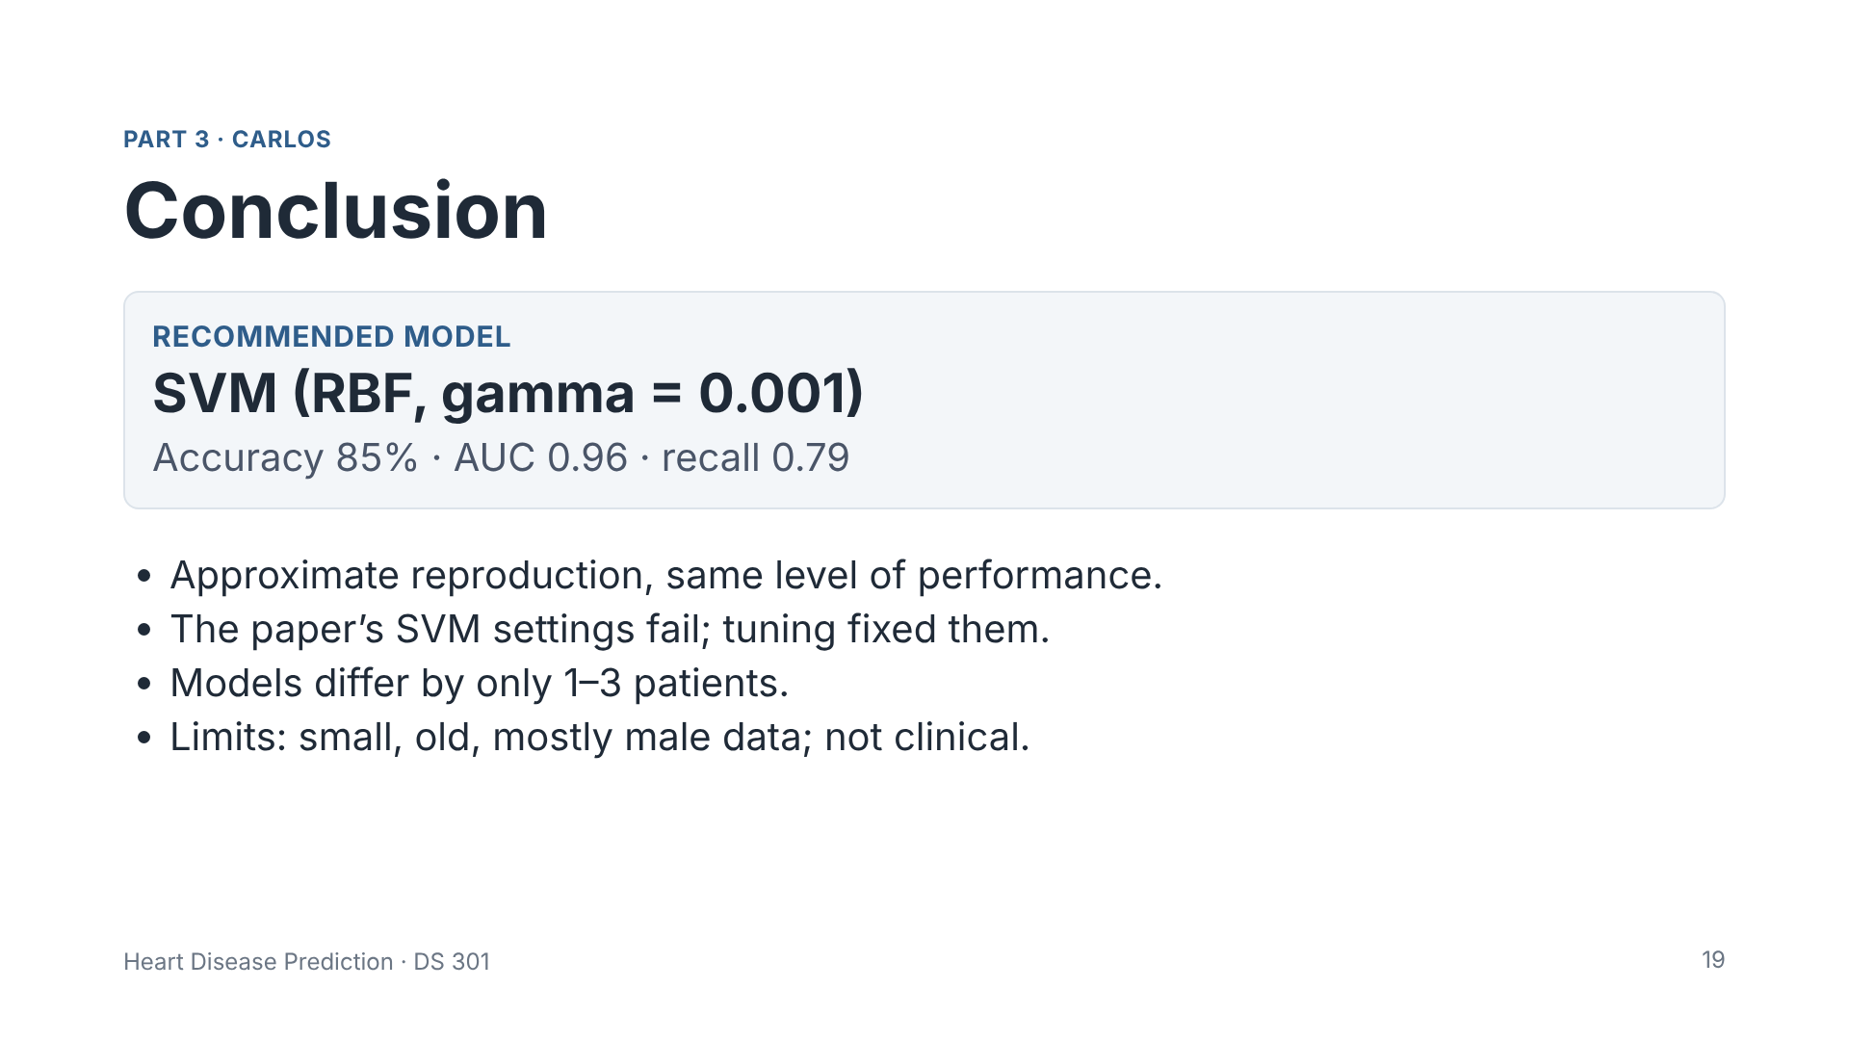
Notes:
Presenter: Carlos. Thank you, Karina. To conclude: we recommend the SVM with gamma 0.001, because it had the best overall balance: 85 percent accuracy, AUC 0.96 and specificity 0.91. We reproduced the paper approximately, and we found that the paper's SVM settings do not work with its own scaling. The differences between the models are small, so this choice should be confirmed with more data. Our main limitations are the small and old dataset, with mostly male patients, and the results are not clinically validated.

Slide 20

Notes:
All presenters. Thank you. We are happy to answer questions. Possible questions: Why recall? Because missing a sick patient is the worst error. Why did the paper's SVM fail? The gamma is too large for the 0 to 10 scaling. Why keep outliers? They are real clinical values and the dataset is small. What is data leakage? When test data influences training; the pipeline avoids it. Why is no model clearly the best? The differences are only 1 to 3 patients out of 60.

